Slide 1

Marketing Retail Analysis
Presentation
By
Prajoth
Great Learning

Slide 2

Agenda -
Agenda of this project is to find the underlying buying patterns of the customers of an automobile part manufacturer. based on the past 3 years of the Company's transaction data and recommend them customized marketing strategies for different segments of customers
Executive Summary of the data-
We have received the 3 years data of automobile part manufacture. Consisting 2747 entries with 20 variable details regarding the demography of the product and customer information.

Slide 3
Content
Problem Statement
Data Summary
EDA
Customer Segmentation using RFM Analysis
KNIME Workflow Image
RFM Analysis Output
Inferences
Business Recommendation

Slide 4

PROBLEM STATEMENT:
An automobile parts manufacturing company has collected data of transactions for 3 years. They do not have any in-house data science team, thus they have hired you as their consultant. Your job is to use your magical data science skills to provide them with suitable insights about their data and their customers.

Slide 5
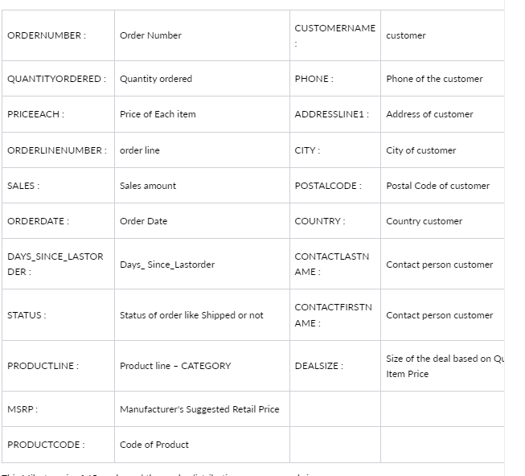
Data Dictionary:

Slide 6
Data Summary:
The data is about an automobile parts manufacturing company. They have provided the data collected of transactions for 3 years.
The data has 2747 entries (0 To 2746) of rows and 20 columns. The data has 1 datetime64 , 2 foat64, 5 int64,and 12 Object data types.
The dataset has both no null values and no duplicate rows of data.
This data more or less reflects the purchasing behavior of customers in different categories . The company is into automobile part manufacture, and they have different product line like Classic car , Motorcycle, plane, train, ship, Bus truck, vintage cars etc.
There is presence of outliers in variables such as Quantity ordered, Price and Sales.
The data maintained each transactions entry as order number and for each order number maintained all required information like customer identity details , and product details like price , quantity , product code, and sales for each customer.
We noticed that one order number has many different entries with different product codes.
Manufacturer's Suggested Retail Price(MSRP) for each product code is decided but we found that this is not matching with Price of Each item & is inconsistent with MSRP.

Slide 7
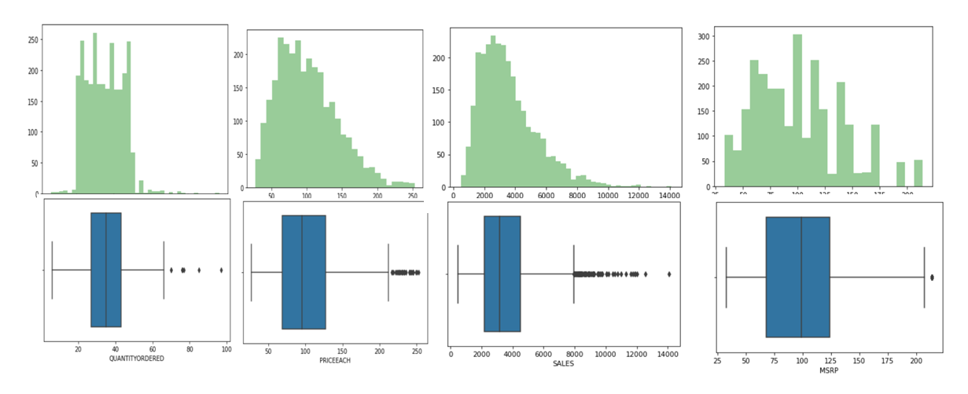
Univariate Analysis:
There is presence of outliers in variables such as Quantity ordered, Price and Sales.
Variable ‘Sales’ has highest positive skewness(0.784) and Variable ‘Days_since_lastorder’ has lowest negative skewness(-0.002)

Slide 8
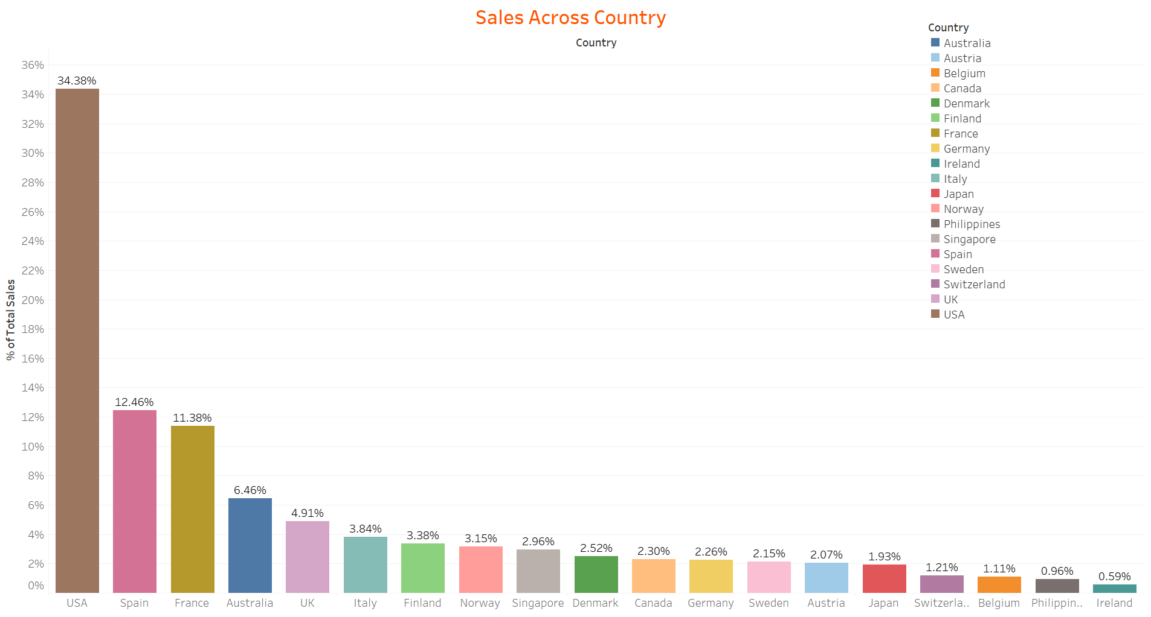
Bivariate Analysis:
USA has highest sales of automobiles and ireland has registered low sales.

Slide 9
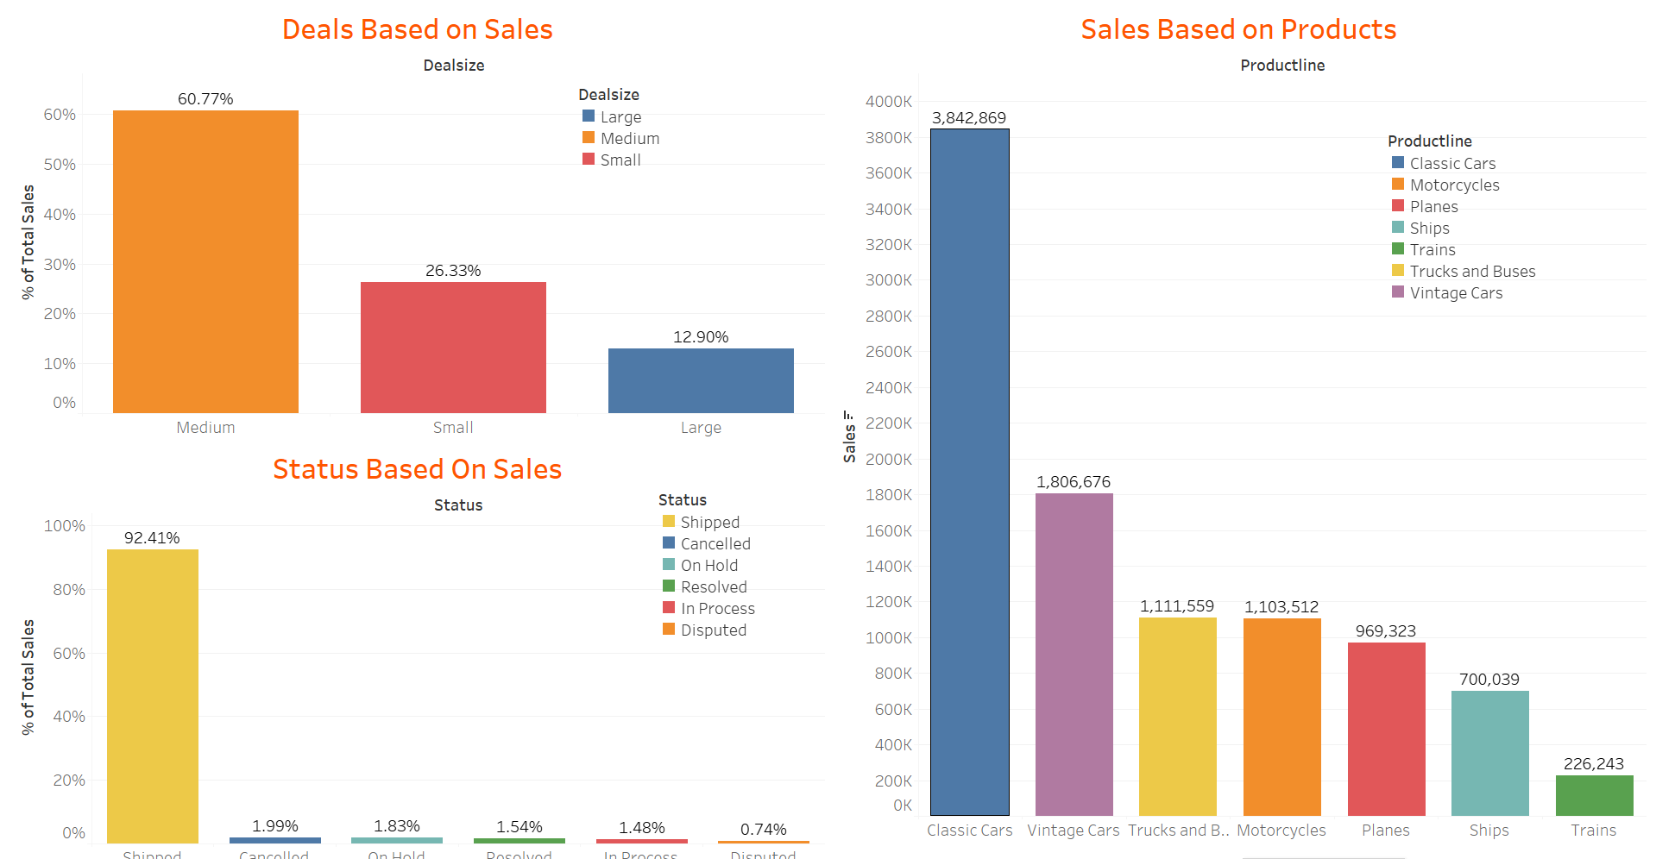
Sales are high for classic cars, the company has even sold below MSRP, there might be a chances that the company has given more discounts to its customers. And vice versa for vintage cars were the company has sold above MSR.

Slide 10
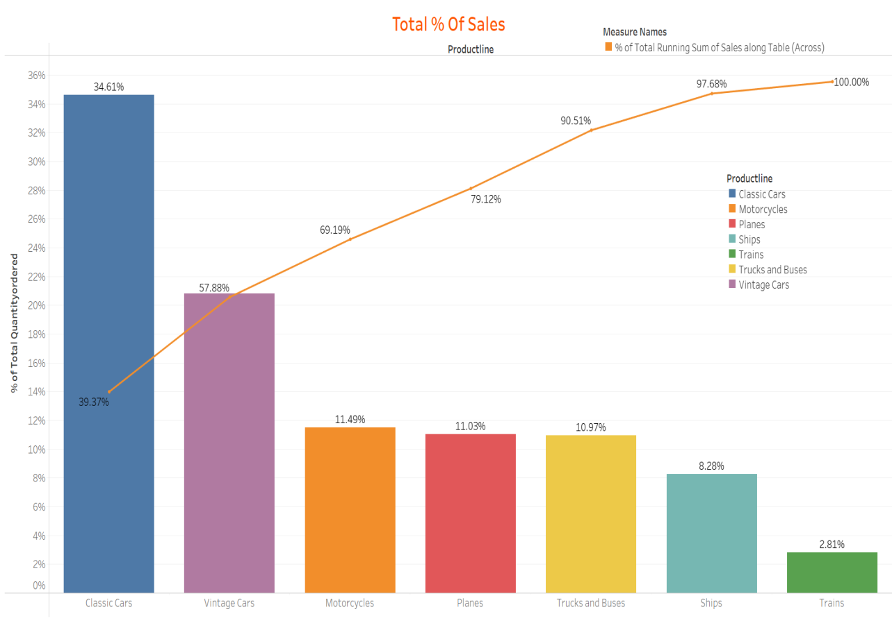
Cummulative Percentage Of Sales Across Product:
Classic and vintage cars has more than 50% of sales. Train has low amount of sales.
Classic car ordered higher amount by customers.

Slide 11
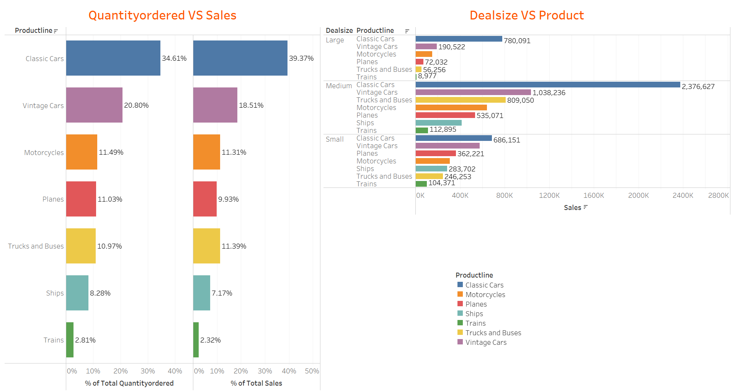

Slide 12
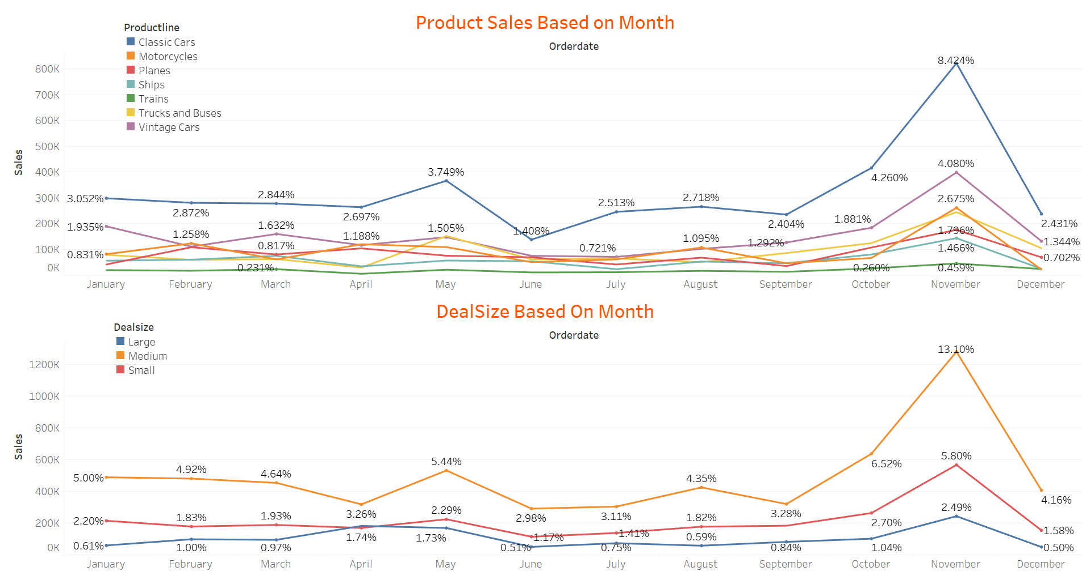
Sales and Dealsize Based On Month:
We observed that in Last quarter sales are high as compared to other quarters. Quarter 2 sales are gradually increasing compared to previous quarters.

Slide 13
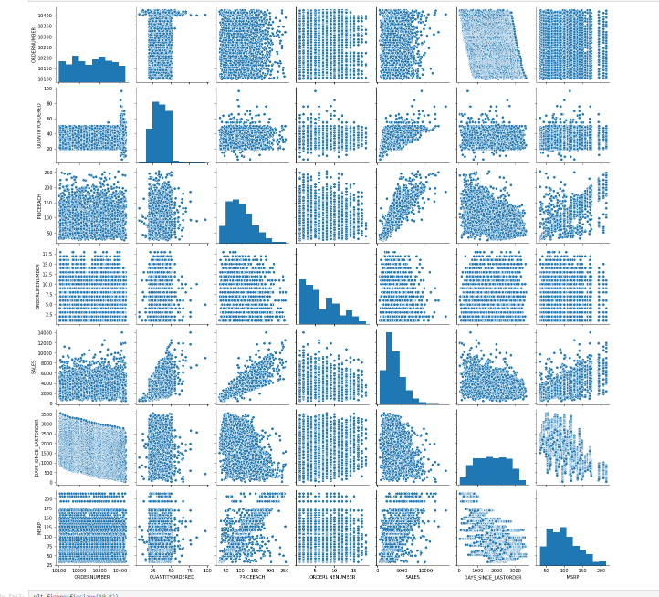
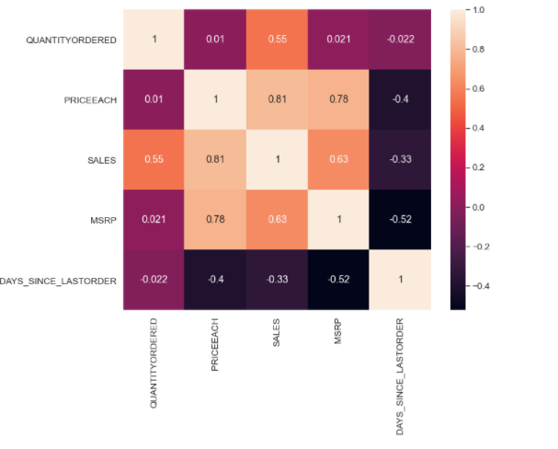
Multivariate Analysis:
Pair Plot and Heat map plotted for continuous variable.
Variables ‘Sales’ and ‘Price each’ have highest positive Correlation(0.81) and Variables ‘Days_since_lastorder’ and ‘MSRP’ have highest negative Correlation(-0.52).

Slide 14
Inference:
After doing the analysis, we can see there is a high demand of classis cars followed by vintage cars and the least is for trains.
Also USA has the highest quantity ordered, in which San Rafael, NYC holds the highest record.
Variables ‘Sales’ and ‘Price each’ have almost linear relation ship between them.
The demand for classic cars are so high that the company have sold the product below MSRP giving the customers a good discount. The sales are high for the last Quarter of the year.
Manufacturer's Suggested Retail Price(MSRP) for each product code is decided but we found that this is not matching with Price of Each item & is inconsistent with MSRP.

Slide 15
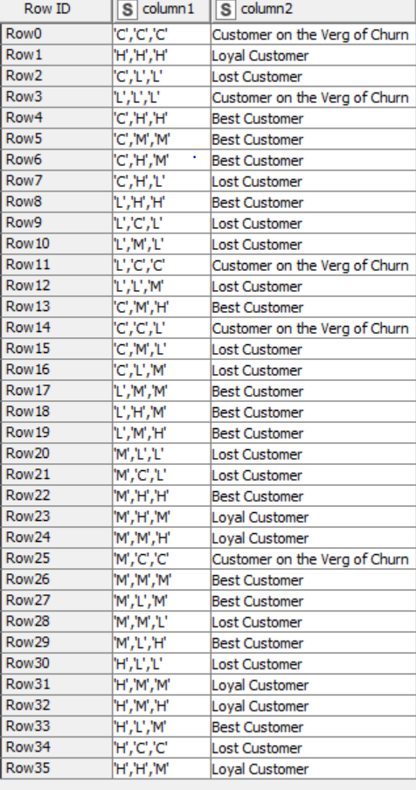
Customer Segmentation Using RFM Analysis:
created new column name Recency as "[Max(order date) - order date)]"We have assumed “30-05-2020“ as a reference date and created recency column.
Customer Segmentation done by using KNIME and MS Excel by dividing the data based on Recency, Frequency and Monetary variables through grouping data by variable ‘Order Number’.As per the suggestion about ignoring the column "Days Since last order" .
Then created four different bin for each Recency, frequency & Monetary using percentile range(0,0.10, 0.70,100).Based on above 4 bin assumption we have considered 4 segments like Loyal (H), Best (M), Lost (L)and the customers on the verge of Churn(C).

Slide 16
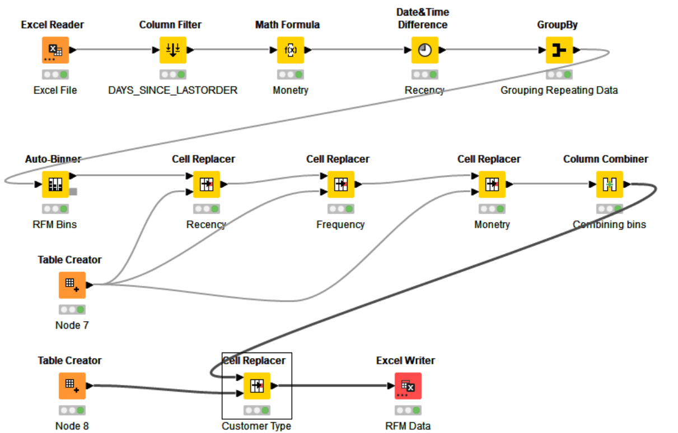
KNIME Workflow for RFM Analysis:

Slide 17
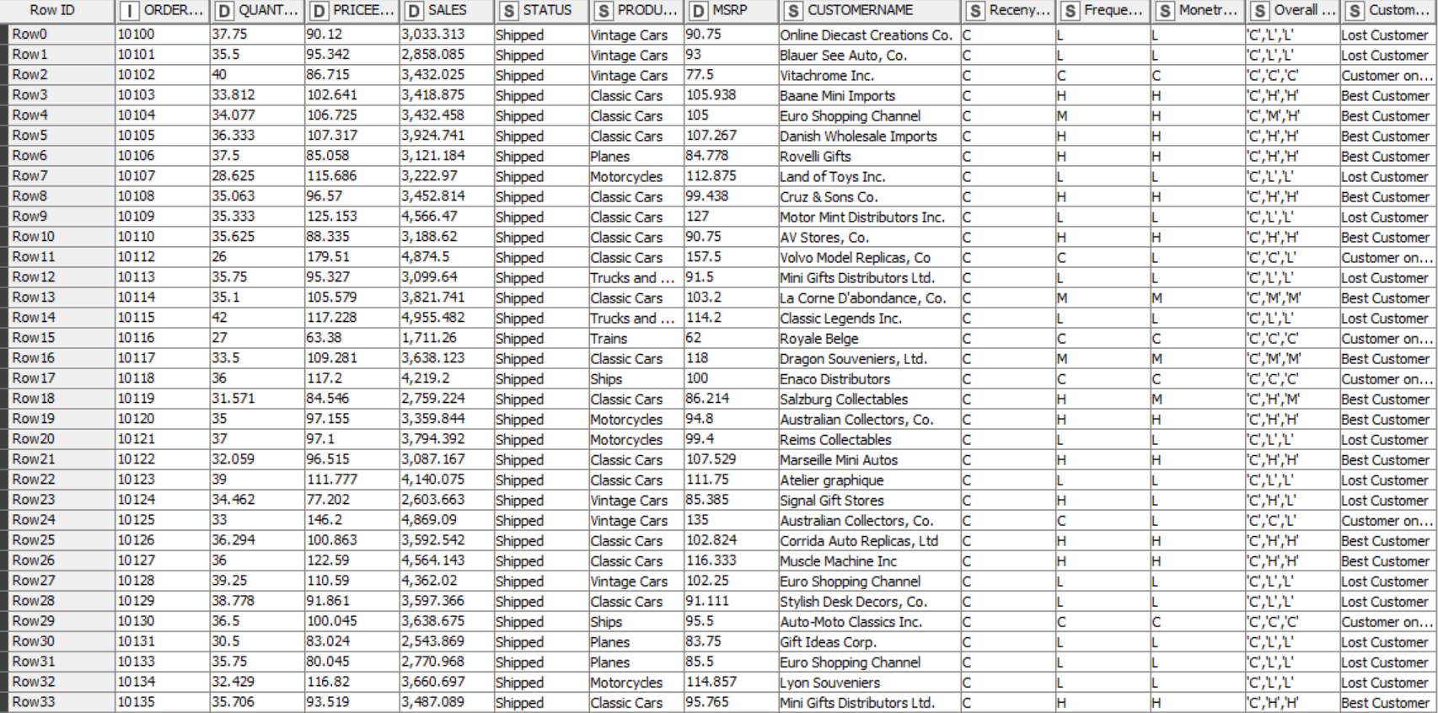
Sample Data With RFM Analysis

Slide 18
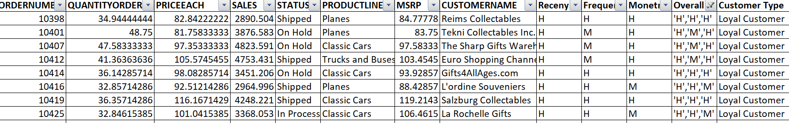
Loyal Customers:
On basis on Recency, frequency & monetary we have grouped our loyal customer's. These customers have purchased multiple times with good monetary value.
These are the still valuable customers as they are with better level in all aspects Frequency and Monetary.
We have to look after the needs of these customers to bring them into the pool of best We should definitely focus on this group before we lose them and try to convert them into our regular customers.

Slide 19
Best Customers:
On basis on Recency, frequency & monetary we have grouped our top customers.
We have given the most significance to recency parameter as these customers has recently purchased our products.
We should not loose these customers at any cost as they are the biggest contributors of the business.

Slide 20
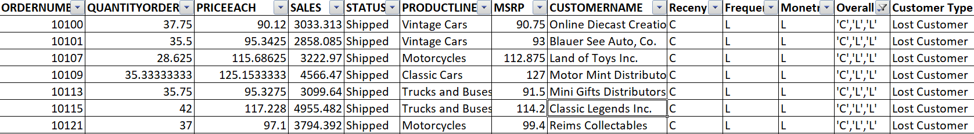
Lost Customers:
As these are the most avoidable customers as they are with lowest level in all aspects Recency, Frequency and Monetary. There is no point in spending time and effort to maintain business with these customers.
On basis on Recency, frequency & monetary parameters we have grouped our Customers who we’d lost
Their recency is very low and hasn’t made any purchase since long. So we can say these are our lost customers. If taken feedback from them and fulfill their demand we might bring them back to been a good customer.

Slide 21
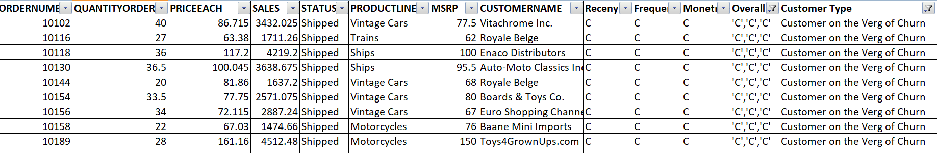
Churn Customer:
On basis on Recency, frequency & monetary we have grouped our Customers who are on verge of churning. We should definitely focus on this group before we lose them and try to convert them into our regular customers.
. If the company pays more attention and fulfill their requirement, then we can easily turn them into our regular customer and we can save them from churning out.

Slide 22
Business Recommendation:
Using Recency, frequency & monetary parameters we have grouped our Top , loyal, on the verge of churning and lose customers.
Customers with good recency has been our top customers were as we also have lost customer lists.
Customers on verge of churning can be saved and can be converted into a good buyer.
RFM model is used for deriving the customers types like Loyal, top or best, on verge of churning & lost customers.
Recency, frequency & monetary parameters were widely used to bifurcate the types of customer's.
This model can be very helpful to the company to maintain its sales and customers and can focus on how the company has lost the customers & can take various actions to bring them back.

Slide 23
It is vital for the company to convert the customers who are on verge of churning into a regular customer or at least maintain them.
And also how to increase the sales ratio can be identified.
Tableau Link:
https://public.tableau.com/app/profile/prajoth4277/viz/MRAMilestone1_16461671704590/Story1

Slide 24

THE END

